Slide 1
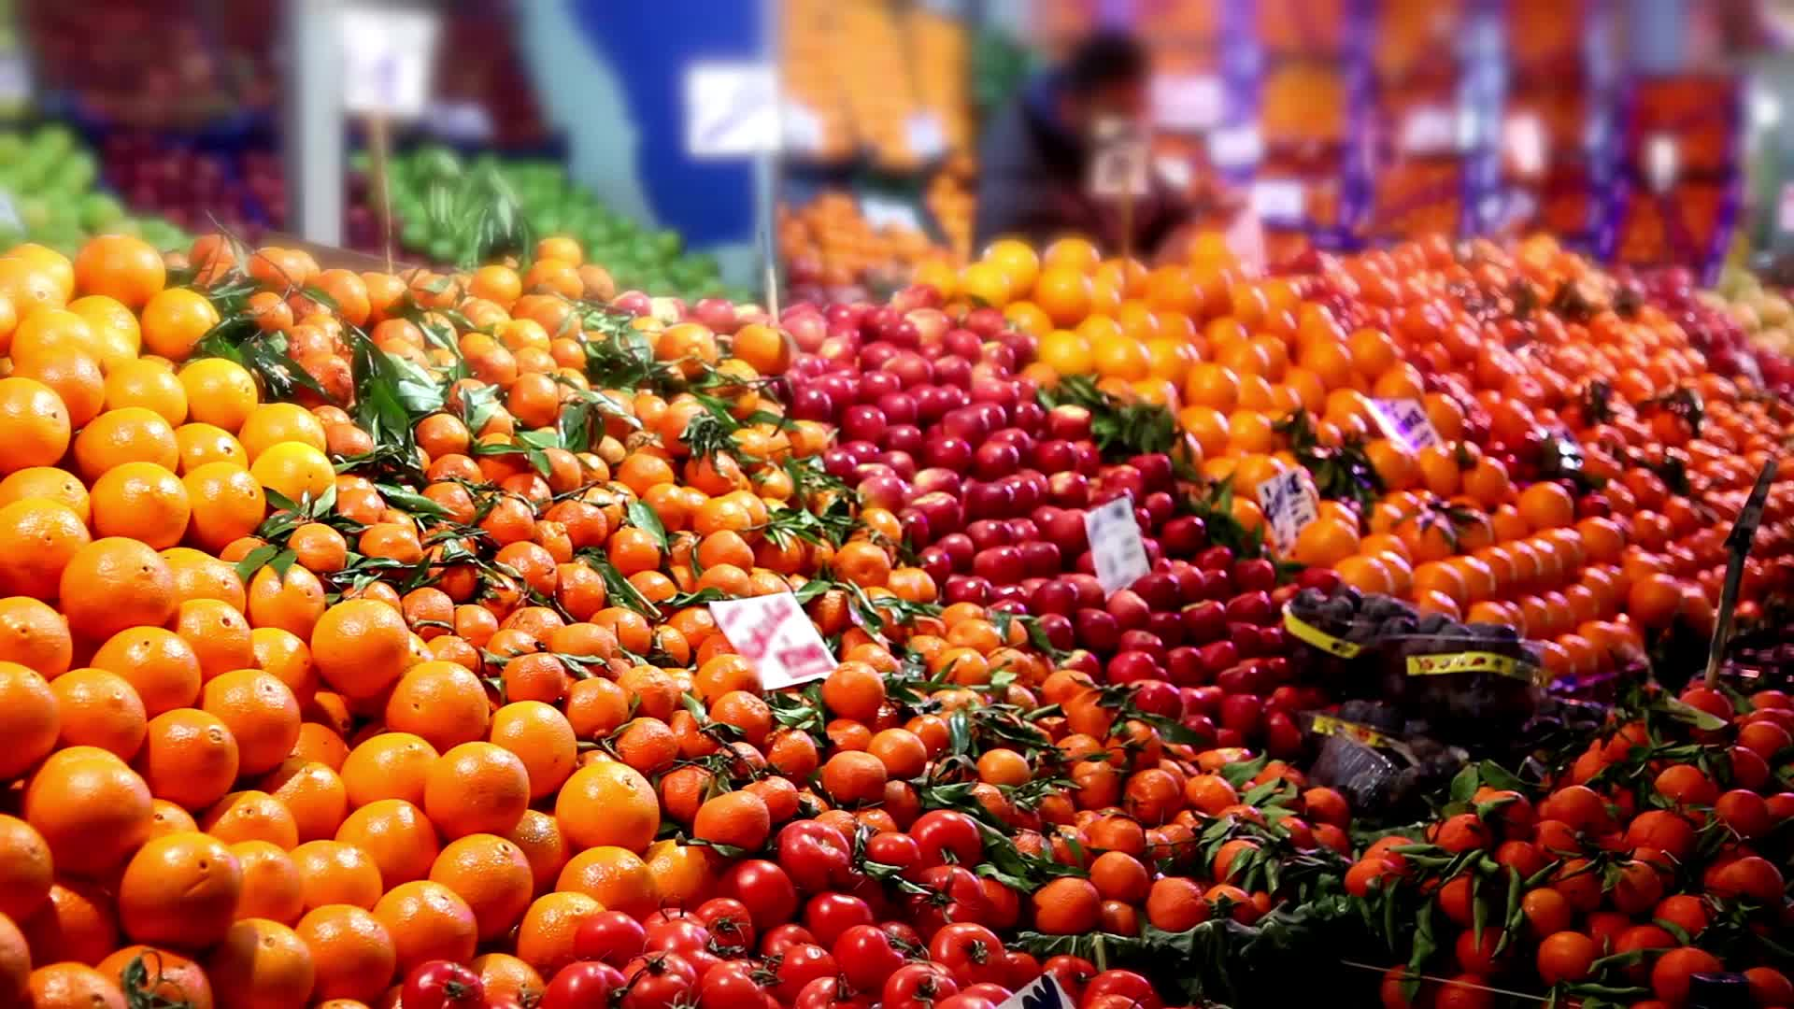
Supermarket Management System
Team Members :
Aya Magdy Galal (Team Leader).
Esraa Abd El-Alim Ali.
Ali Ahmed Abd Elaazim Ryad.
Mohamed Ahmed Hassan syam.
Hager Mohamed Abd Elmaaboud .
Hadeer Saber Hassan .
Hossam Mahmoud Abd Elhadi.

Slide 2

Table of contents :
Introduction
The parts of the project:
GUI
Login frame
Home frame
Grocery home frame
Search frame
Update & Delete

Slide 3
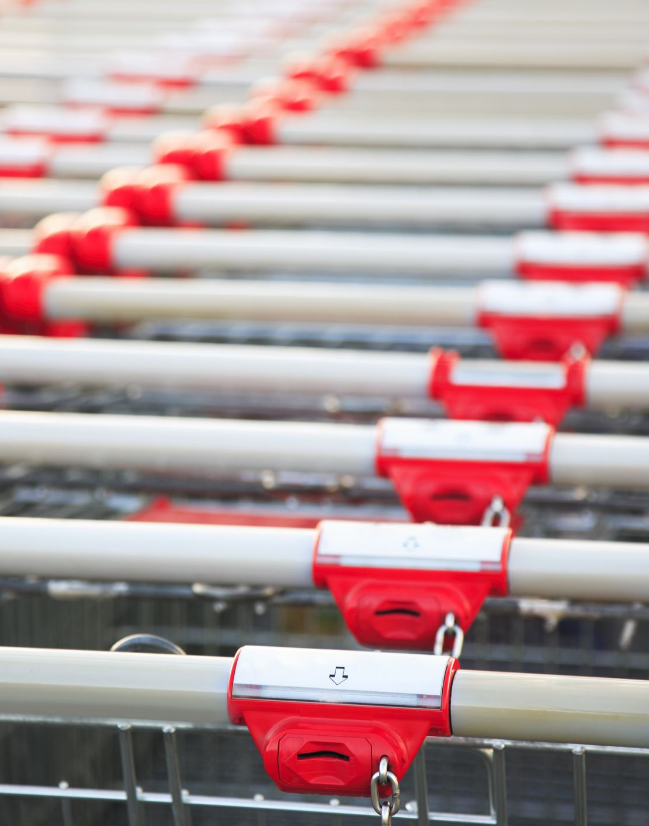
Introduction :
Supermarket Management System is created using Python to easily manage all supermarket related functions by a single user. As a terminal application, the users can perform basic operations of their supermarket such as additional items, view items, clear items/stocks, purchase items, search for specific products in the stocks and edit any items/products placed in the system record.

Slide 4

Parts of the project
GUI
Login Form
Home Form
Grocery Home Form
Search Form
Update & Delete Form
Database using sqlite3

Slide 5
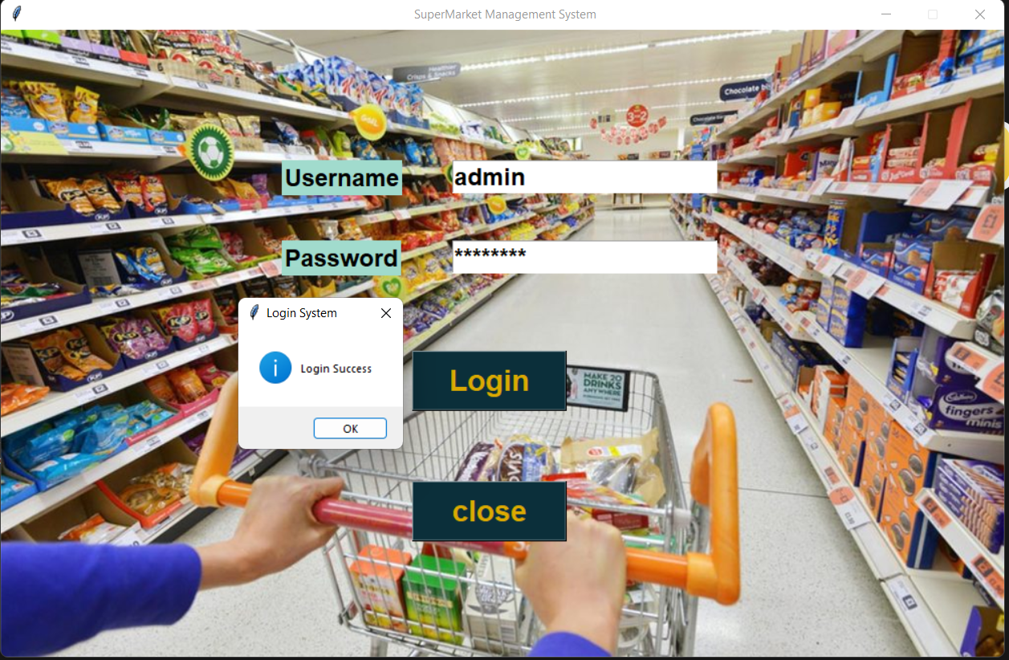
GUI : Login Form
when you enter the correct username and password then click login you will be directed to the next frame

Slide 6
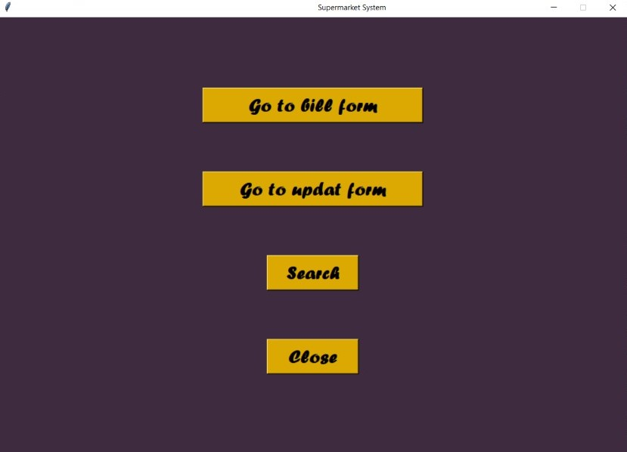
GUI : Home Form
When you click on go to bill form button you will go to bill frame and when you click on go to update form button you will go to update and delete frame and When you click on search button you will go to search frame and When you click on close button you will exit this frame

Slide 7
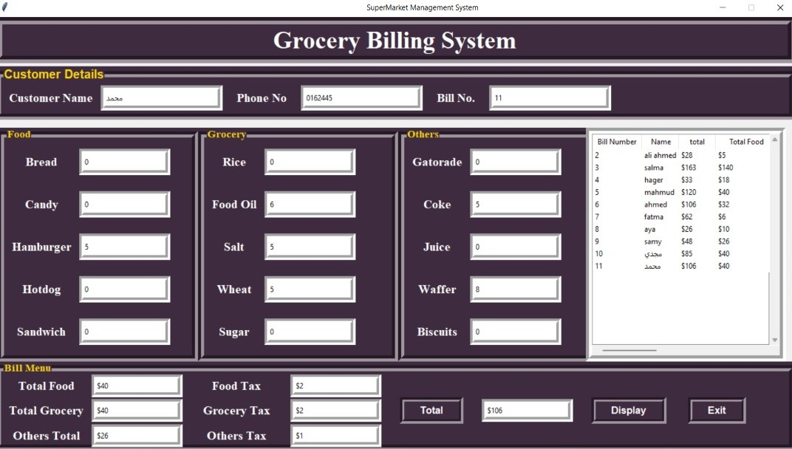
GUI : Grocery Home Form
The employee writes the name of the customer, his phone number, the bill number, then selects the products that the customer wants to buy, then presses the Total button, so the total price and the price of each category separately and the taxes for each category will appear. When you click on display the bill is saved in the database.

Slide 8
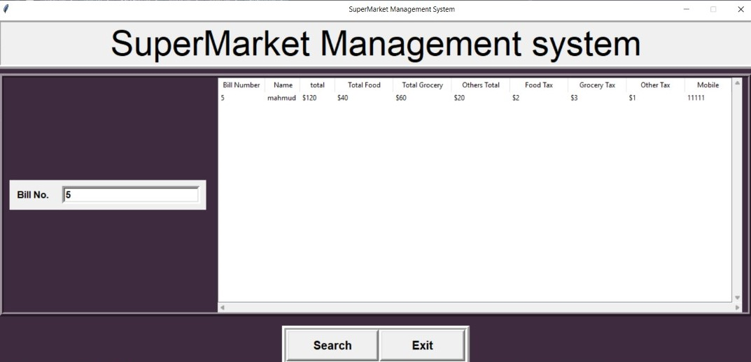
GUI : Search Form
Where we can search for a bill by using bill number and it shows some information about the process of selling like bill number and the name of the customer and the total , total food , total Grocery and mobile number

Slide 9
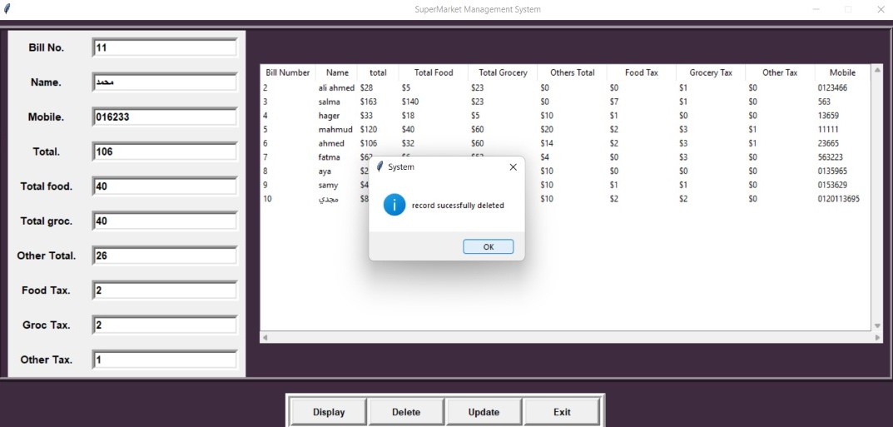
GUI : Update & Delete Form
Where we can update data and delete it when needed

Slide 10
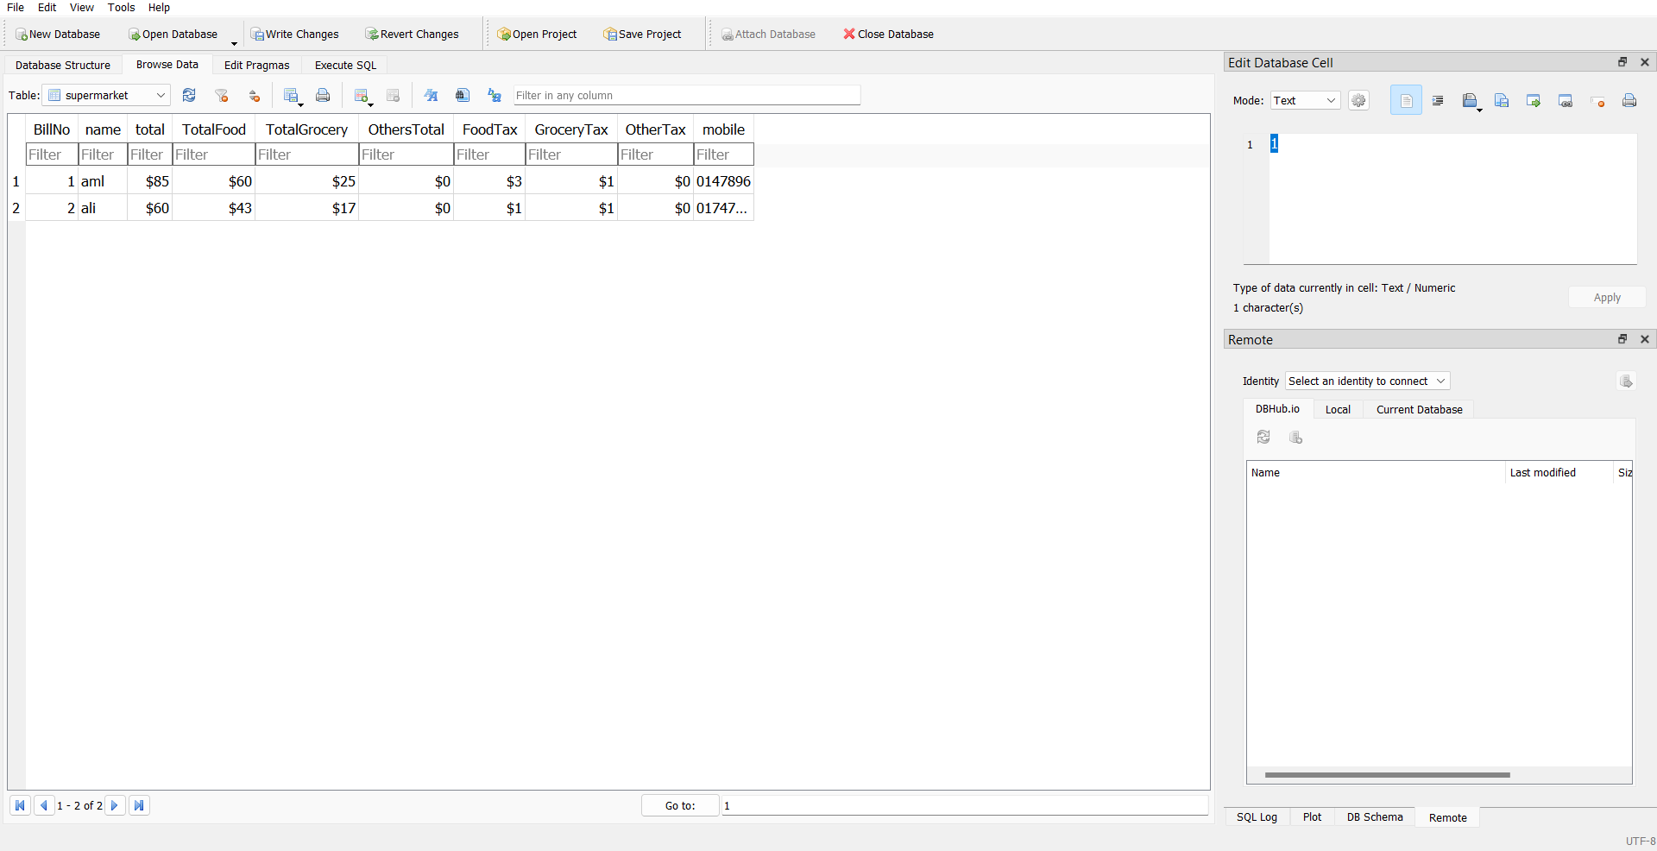
Database using SQLITE3
Where the program data is stored

